Slide 1


ADA Transition Plan
Baltimore City
Public Participation
October 18, 2023
5:30 PM to 7:30 PM

Slide 2

Agenda
Agenda
Introductions
Rules for a successful meeting
Brief overview of ADA and City ADA Transition Plan
Status update on the Transition Plan development
What we heard from you at prior public meetings
Detailed look at the proposed prioritization methodology
Feedback and next steps

Slide 3
Introduction
Introductions
Presenter – Valorie LaCour, Chief of the ADA Compliance Division, Agency ADA Coordinator
Welcome to each of you attending tonight
Sign language interpreter
Thank you to University of Maryland BioPark for providing this location for the public meeting

Slide 4
A Successful Public Meeting
A Successful Public Meeting
For those attending virtually:
  Please mute your microphone
  Please turn off your video
  Please use the chat function for questions
For those attending in-person
  Silence your cell phone
  Please hold your questions until the end of the presentation
The meeting materials were uploaded to the website yesterday and are available for your review.

Slide 5
Americans with Disabilities Act (ADA)
Americans with Disabilities Act (ADA)
Americans with Disabilities Act of 1990
  Signed into law July 26, 1990
  Wide-ranging civil rights law that prohibits, under certain circumstances, discrimination based on disability
  Affords similar protections against discrimination to Americans with disabilities as the Civil Rights Act of 1964
Title II of ADA – Nondiscrimination on the basis of disability in state and local government services

Slide 6
ADA Transition Plan Overview
An ADA Transition Plan is required by the Americans with Disabilities Act (ADA) Title II
An ADA Transition Plan identifies existing programs, services, facilities, policies and procedures that require changes, and outlines the steps necessary to become accessible
Baltimore City is currently developing an ADA Transition Plan to bring city-owned pedestrian infrastructure into ADA compliance

Slide 7
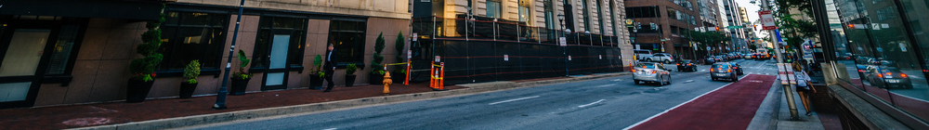
ADA Transition Plan Elements
ADA Transition Plan Elements
The major elements of an ADA Transition Plan include:
  Methods for Compliance
  Public Input
  Prioritization
  Commitments and Funding
  Schedule
  Designation of an ADA Coordinator

Slide 8
ADA Transition Plan Schedule
ADA Transition Plan Schedule
Transition Plan Element | Status
Self-Assessment | In progress
Designation of an ADA Coordinator | Completed
Methods for Compliance | In progress
Public Input | In progress - Public meetings held 1/27/22 and 9/29/22
Prioritization | In progress - The Focus of Tonight’s Meeting
Commitments and Funding | In progress
Schedule | In progress

Slide 9
Public Input
Public Input
A few of the key themes we heard from the public:
    Importance of access to important destinations such as employment, medical facilities, post offices, banks, grocery
    Emphasis on neighborhood connectivity and transit access
    Need for better pedestrian signals with features such as audible countdowns – especially at complex intersections
    Need for improvements to pedestrian safety and lighting, especially near transit stops
    Understand where disabled residents live to help focus improvements

Slide 10
Prioritization Process
Prioritization Process
Prioritization is the process of determining where/what ADA upgrades are most needed
Tool to help guide the implementation of specific projects
Goal is to focus initial efforts and funding on projects in areas identified as high priority
The City has considered public input received so far in developing the proposed prioritization methodology

Slide 11
Prioritization Methodology
Prioritization Methodology
Proposed prioritization methodology:
  Based on land use and demographic factors throughout Baltimore
  Serve the most critical life functions
Ten (10) prioritization criteria were established, and each was given a point ranking
  A GIS-based prioritization map was created, combining all destinations from the 10 prioritization criteria with their respective point values.

Slide 12
Prioritization Criteria
Prioritization Criteria
Proposed Prioritization Criteria | Maximum Possible Points
1. Equity Priority Areas | 7 pts
2. Mobility Access | 6 pts
3. Health Care Facilities | 5 pts
4. Educational Facilities | 4 pts
5. Employment Areas | 4 pts
6. Pedestrian Hazards | 3 pts
7. Parks and Recreation | 3 pts
8. Government Offices | 2 pts
9. Police and Fire Stations | 1 pt
10. Residential and/or Commercial Land Use | 1 pt

Slide 13
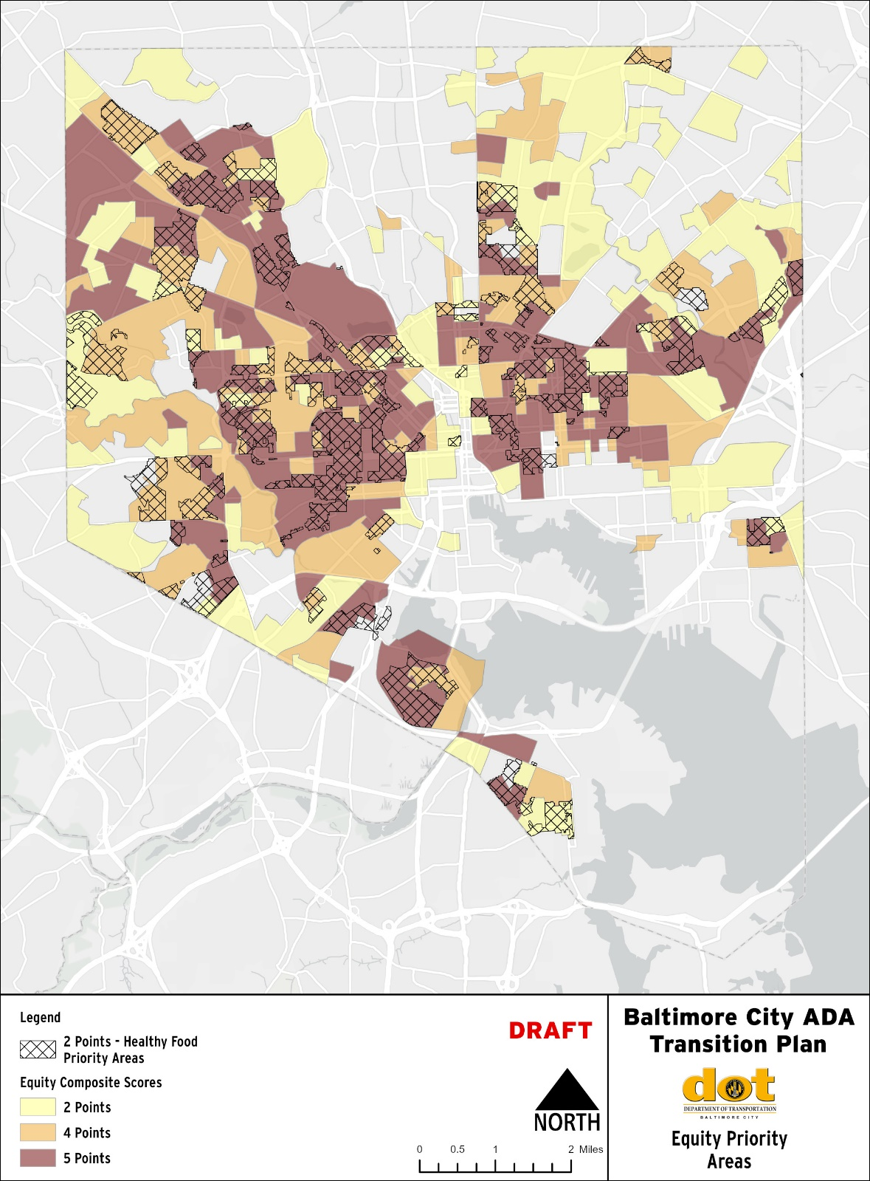
Equity Priority Areas
Equity Priority Areas
Identified using Baltimore City’s Equity Composite Score and Healthy Food Priority Areas
  Equity composite scores consist of the following demographic indicators:
    Populations with a Disability
    Commuters Using Public Transportation
    Black and African American Populations
    Hispanic and Latino Populations
    Populations Living Below the Poverty Line
    Households with No Vehicle Access
    Median Age of the Population
    Unemployment
    Educational Attainment
  Equity Composite Scores given point values of 2, 4, or 5 points.
  Healthy Food Priority Areas given an additional 2 points
  Total maximum score: 7 points

Slide 14
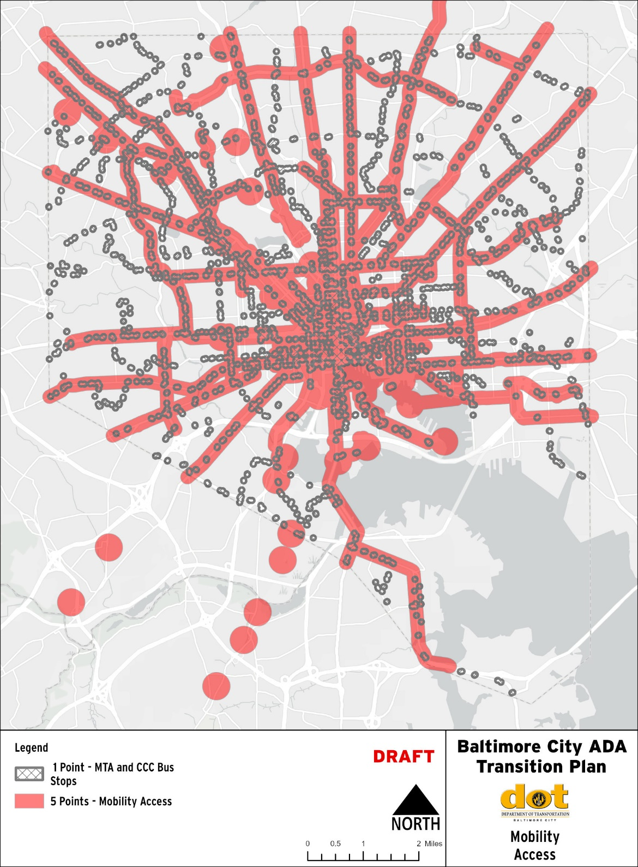
Mobility Access
Mobility Access
2. Includes:
  Areas within 1/8 mile of :
    Gateway Corridors
    Priority Bus Transit Corridors
    Charm City Circulator Routes
    Separated Bike Lane Network
  Areas within ¼ mile of :
    MTA Metro SubwayLink
    MTA Light RailLink
    Amtrak
    Water Taxi Stops
  MTA Mobility customers and residential handicap parking permits
  Score: 5 points
Note: All areas within 300 feet of MTA or CCC bus stops receive one additional point for a total maximum score of 6 points

Slide 15
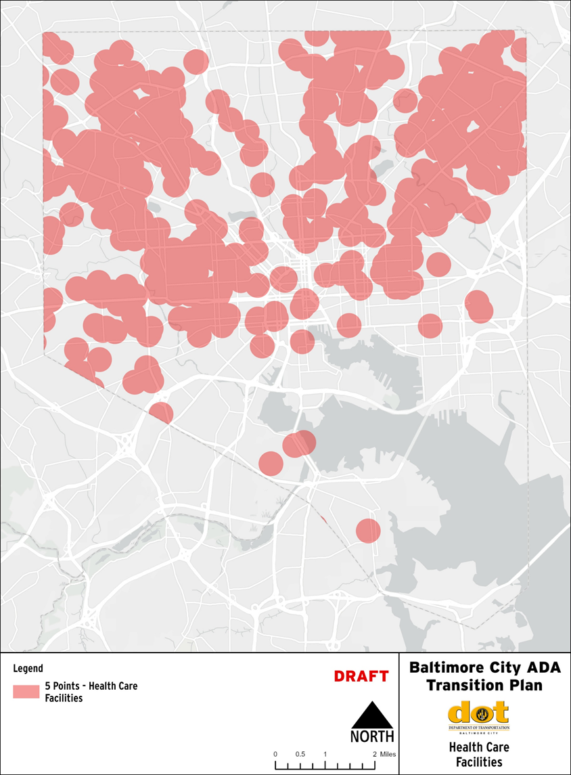
Health Care facilities
Health Care Facilities
3. Areas within ¼ mile of:
    Hospitals
    Assisted Living
    Dialysis
    Geriatric Care
    Hospice
    Long-term Care
    Psychiatric Hospitals
    Rehabilitation Hospitals
    Other health facilities
  Score: 5 points

Slide 16
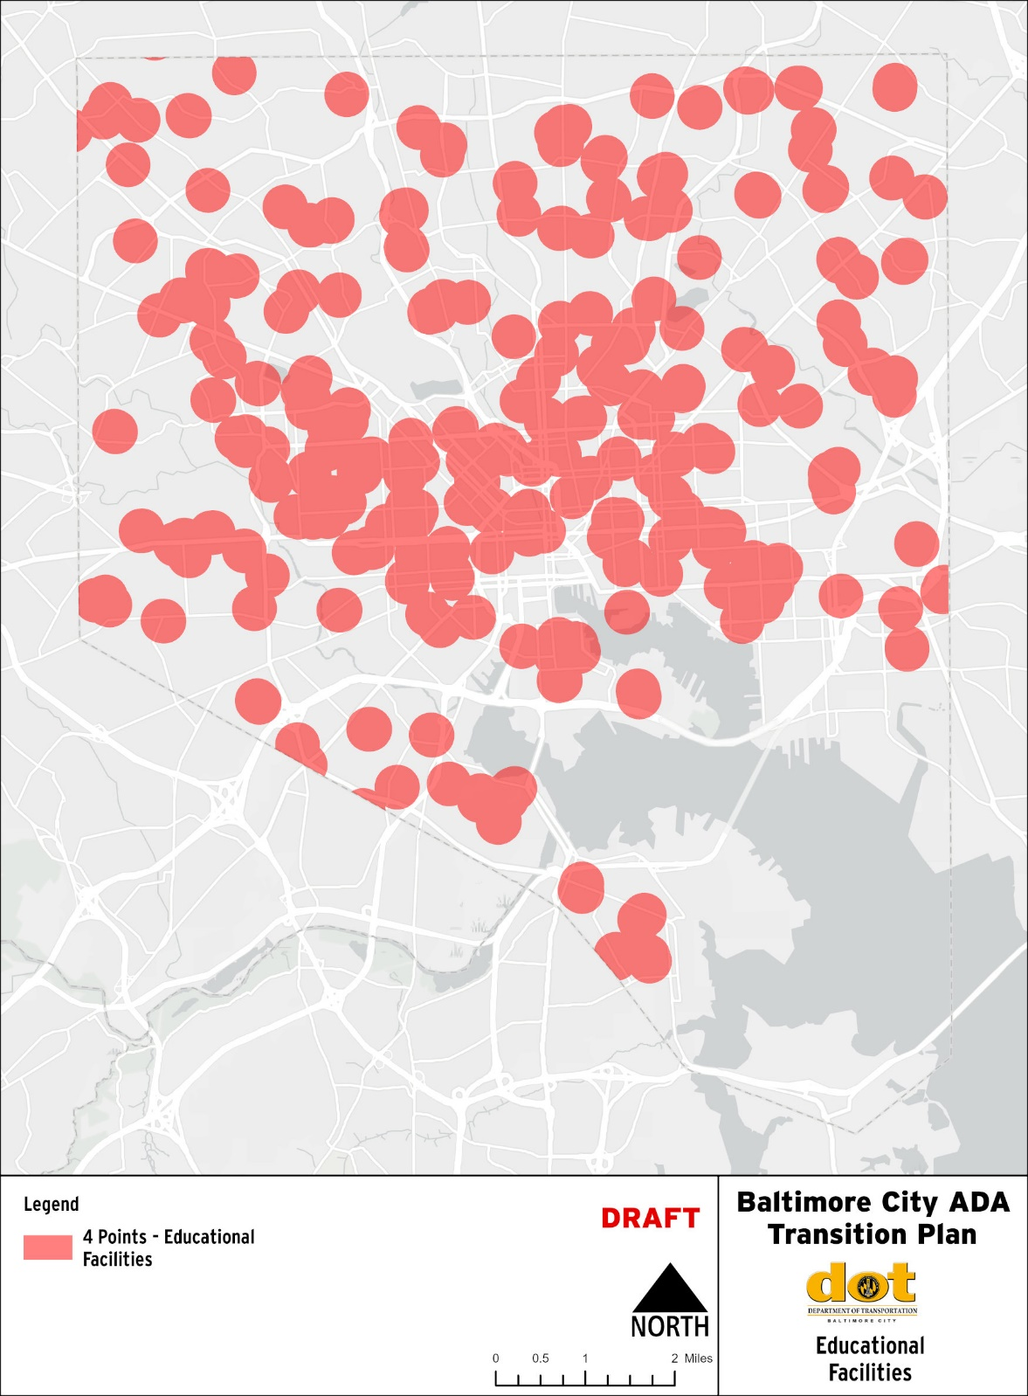
Educational Facilities
Educational Facilities
4. All areas within ¼ mile of:
    BCPSS
    Public Libraries
    Higher Education
    Other Schools
  Score: 4 points

Slide 17
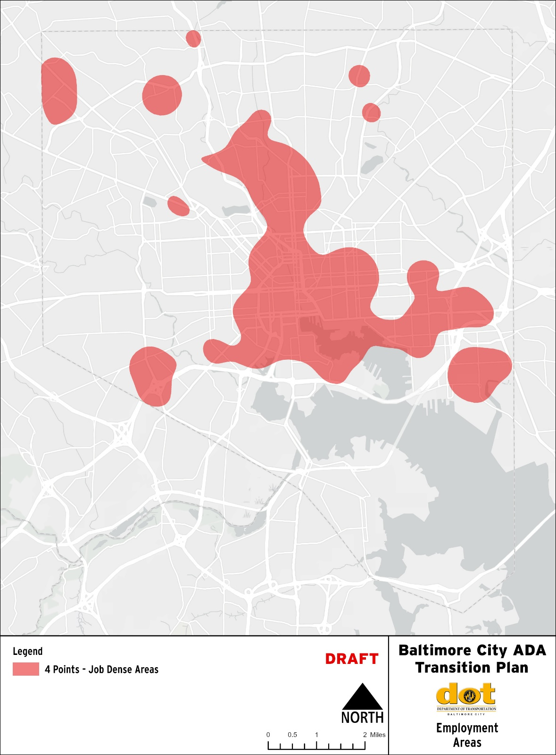
Employment Areas
Employment Areas
5. US Census Data used to identify areas of high job density
  Score: 4 points

Slide 18
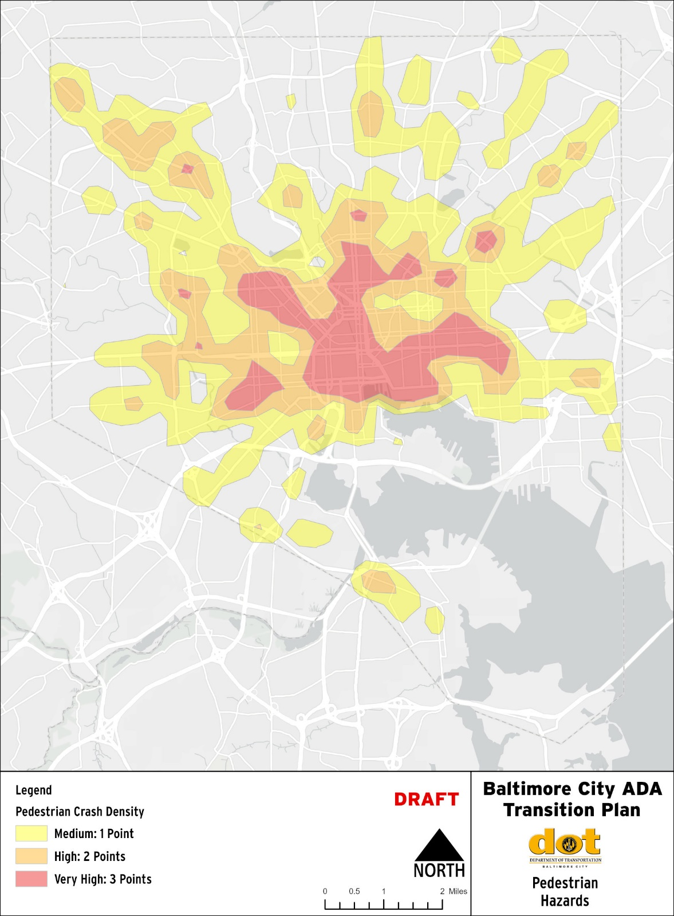
Pedestrian Hazards
Pedestrian Hazards
6. Pedestrian crash data was used to identify areas where pedestrian crashes have occurred
  Score:
    Medium pedestrian crash density: 1 point
    High pedestrian crash density: 2 points
    Very high pedestrian crash density: 3 points

Slide 19
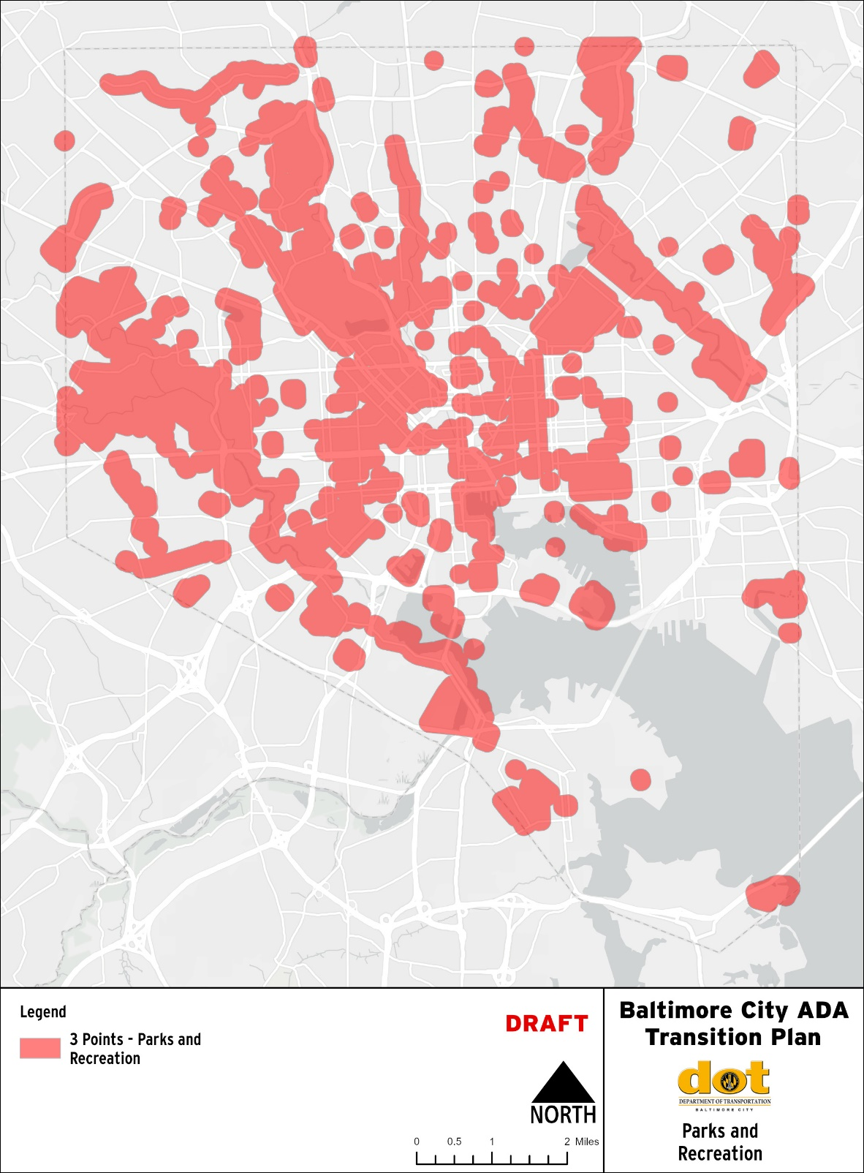
Parks and Recreation
Parks and Recreation
Areas within 1/8 mile of:
    public parks
    recreational facilities
  Score: 3 points

Slide 20
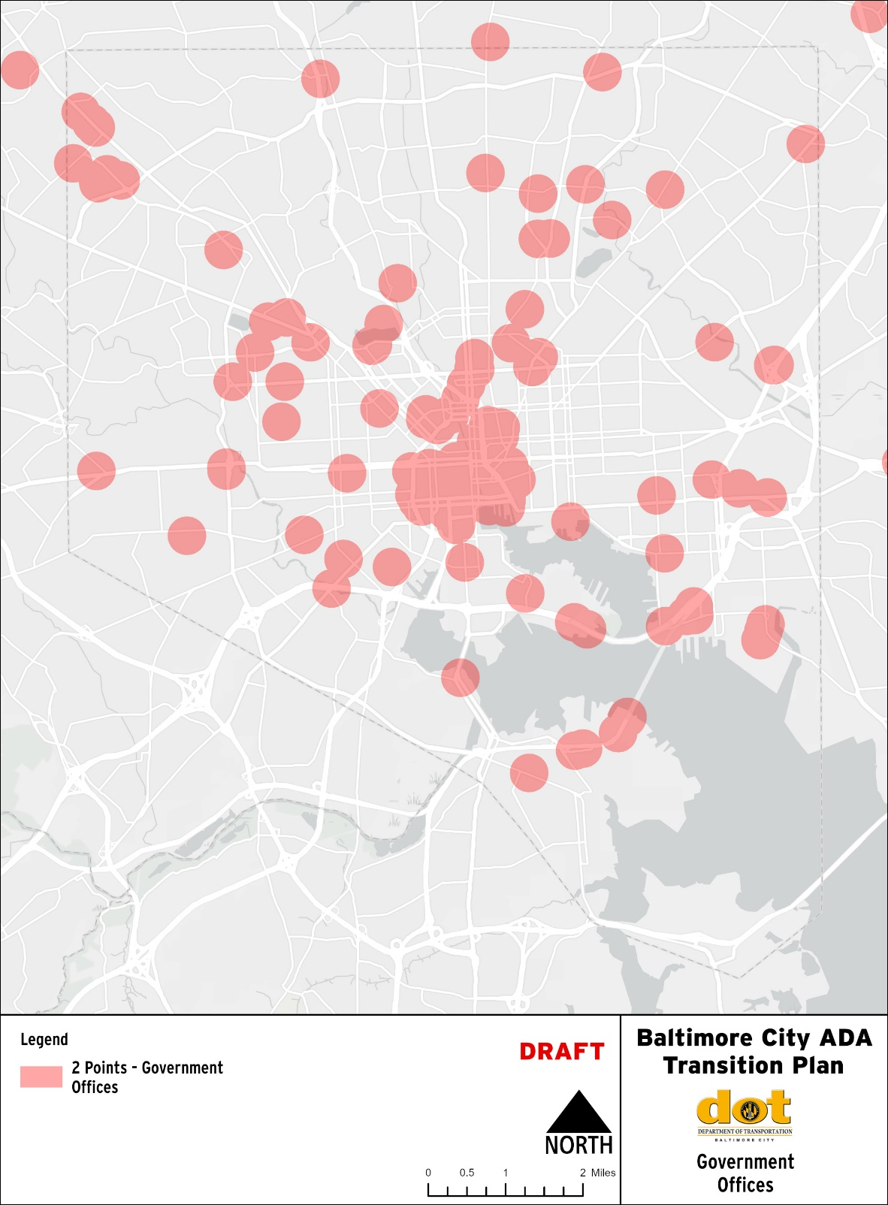
Government Offices
Government Offices
8. Areas within ¼ mile of:
    City
    State
    Federal
    Post offices
  Score: 2 points

Slide 21
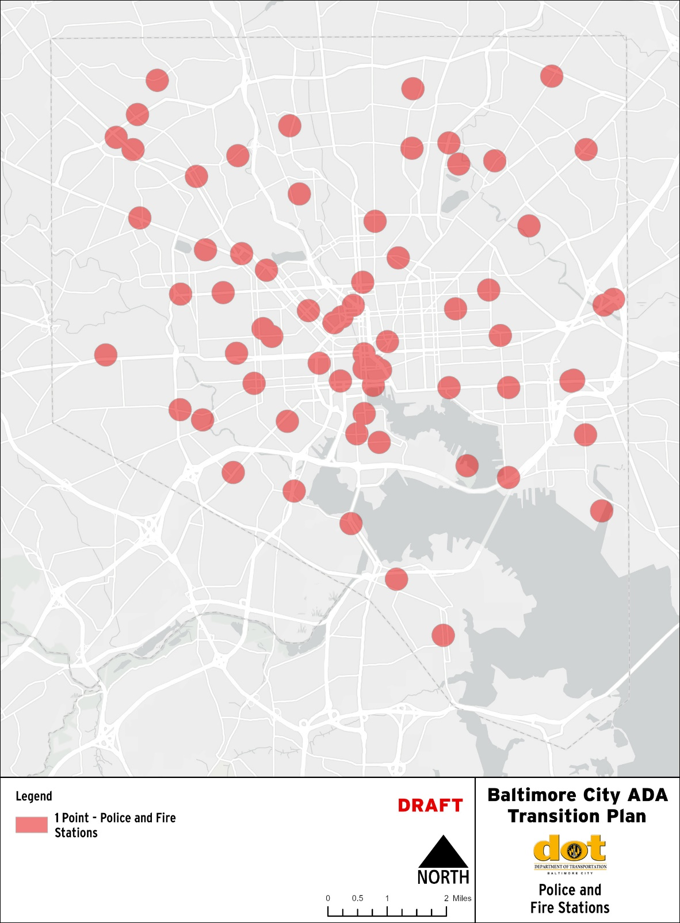
Police and Fire Stations
Police and Fire Stations
9. Areas within ¼ mile of a police or fire station
  Score: 1 point

Slide 22
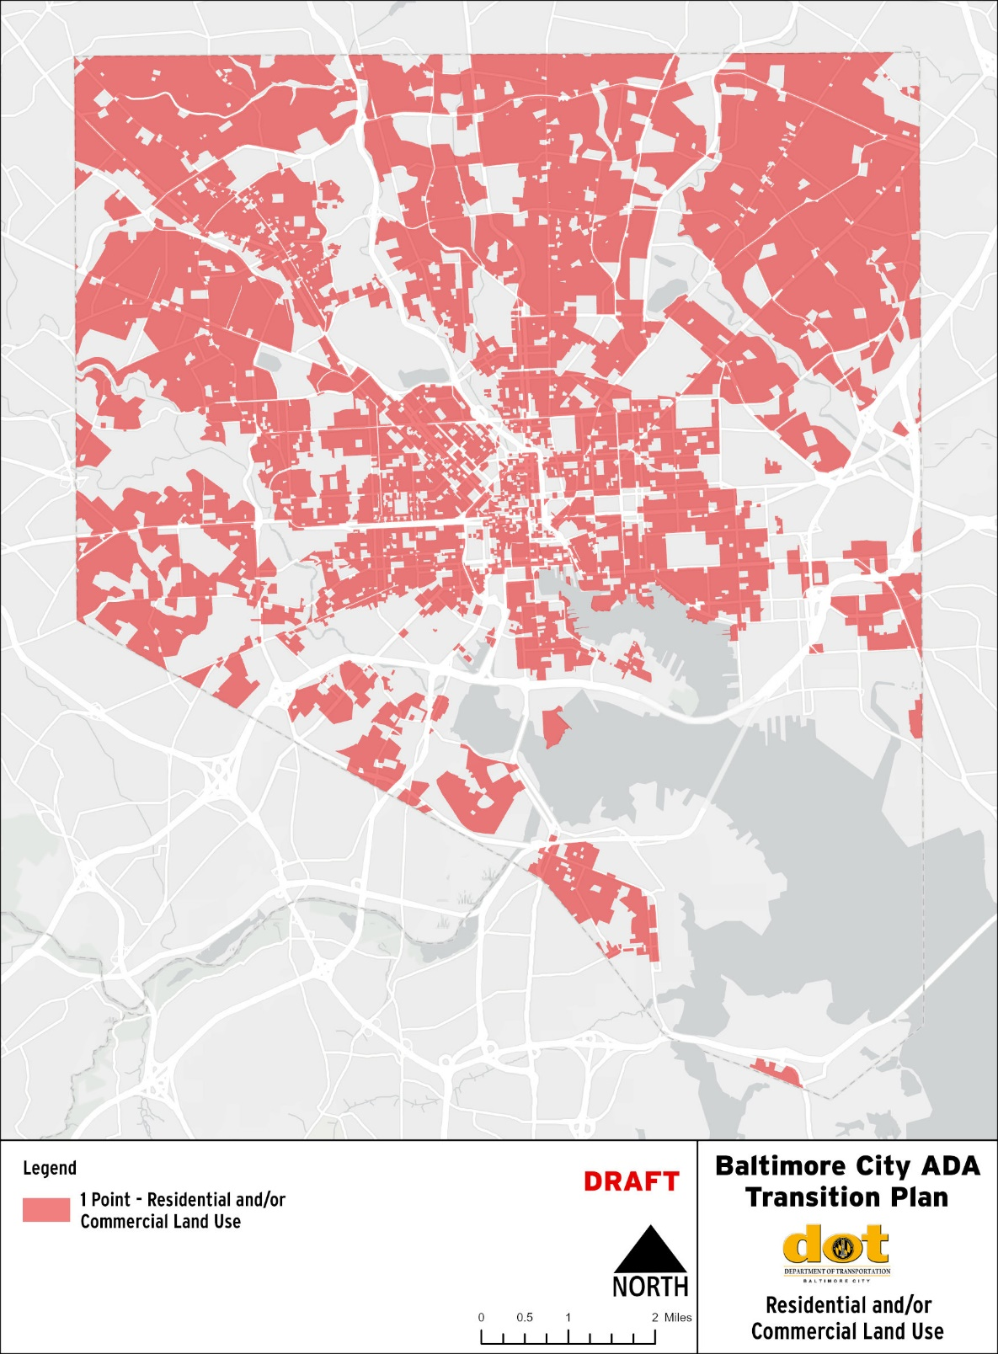
Land Use
Land Use
10. Areas of residential and/or commercial land use
  Score: 1 point

Slide 23
Prioritization Results
Prioritization Results
Scores range from 0 to 36 points. Higher scoring areas should be prioritized first, followed by lower scoring areas.
The color-coded output “heat” map reflects five classes of priority score.
Score classes correspond to:
  1 - 24th percentile
  25 - 49th percentile
  50 - 74th percentile
  75 - 89th percentile
  90th + percentile of scores

Slide 24
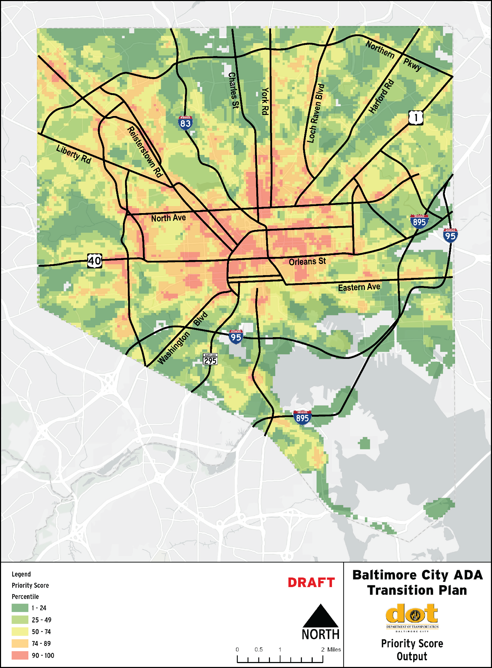
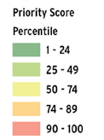
Prioritization Results Map
Prioritization Results Map
LOWER
PRIORITY
HIGHER
PRIORITY

Slide 25
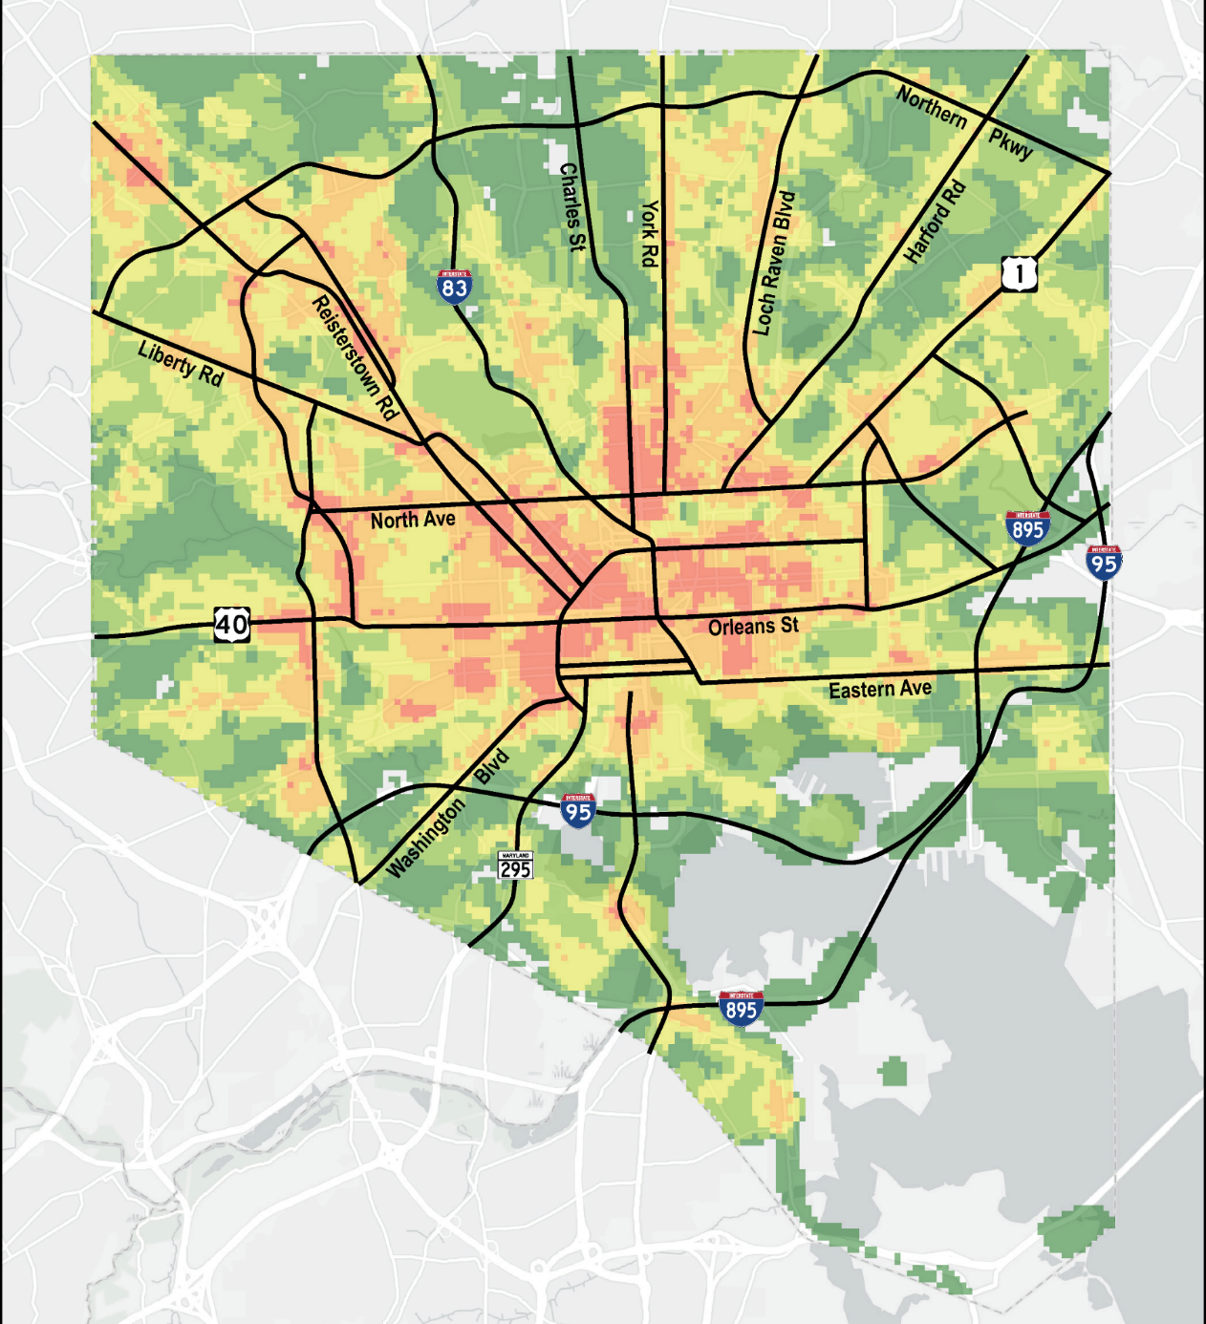
Prioritization Results Map Enlargement
DRAFT

Slide 26
Next Steps
Next Steps
  Solicit your input on the prioritization process
    We would appreciate feedback on the comment card provided this evening.
  Methods of Compliance
    Standard details for ADA will be uploaded to the BCDOT website in November for a 30-day comment period.
  Next Public Meeting for the ADA Transition Plan
    April 2024.

Slide 27
Contact DOT
Contact DOT
BCDOT’s website:
  https://Transportation.Baltimorecity.gov/ada-transportation
By email
  ADACoordinator@baltimorecity.gov
  Or
  Valorie.lacour@baltimorecity.gov
By mail
  Baltimore City
  Department of Transportation
  Attn: Valorie LaCour, ADA Coordinator
  417 East Fayette Street, 5th Floor
  Baltimore, MD 21202

Slide 28
Question & Answer Session
Question & Answer Session
For those attending virtually, please type your questions and comments in the chat
  Or submit a comment or question via email
For those attending in-person, please raise your hand if you have a question or comment
  Or please fill out a comment card

Slide 29
Question & Answer Session
Thank you for attending

